Slide 1


A Personalized Online Course Recommender System with Machine Learning
Muhammad Ikram Shahzad
29-01-2024

Slide 2

Outline
Introduction and Background
Exploratory Data Analysis
Content-based Recommender System using Unsupervised Learning
Collaborative-filtering based Recommender System using Supervised learning
Conclusion
Appendix

Slide 3
Introduction
This project implements and deploys several AI course Recommender Systems using Streamlit. The final codebase and the deployment can be seen here:
https://github.com/mxagar/course_recommender_streamlit
https://ai-course-recommender-demo.herokuapp.com/
The application is the final/capstone project of the IBM Machine Learning Professional Certificate offered by IBM & Coursera.
The most important dataset of the project is a ratings dataframe in which we have 233,306 entries with a user id, course id and an associated rating (2: audited, 3: finished). In addition, to that, we also have another dataset with 307 course entries, each with course descriptions and one-hot encoded genre values (14 genres/topics). From those, we can
build user profiles,
compute user and course similarities,
infer latent user and course features,
build recommender models, both content-based and with collaborative filtering.

Slide 4
Introduction, contd.
All in all, the following models are created:
Content-based: user and course features (i.e., genres/topics) are known:
Course Similarity: course descriptors formed by bags-of-words of course descriptions.
User Profile: user descriptors formed by the genre preferences derived from course ratings.
Clustering: K-means applied to user profile vectors to discover most common courses per cluster.
Clustering with PCA: equivalent to the previous, but with dimensionality reduction.
Collaborative Filtering: user and course features (i.e., genres/topics) are not known, or they are inferred:
KNN: course similarities based on the ratings provided by all users.
NMF: ratings table factorization to discover latent course and user features.
Neural Network (NN): user and course pairs mapped to ratings with intermediate embeddings.
Regression with Embedding Features: embeddings from NN used to regress ratings.
Classification with Embedding Features: embeddings from NN used to infer rating classes.

Slide 5
Exploratory Data Analysis

Slide 6
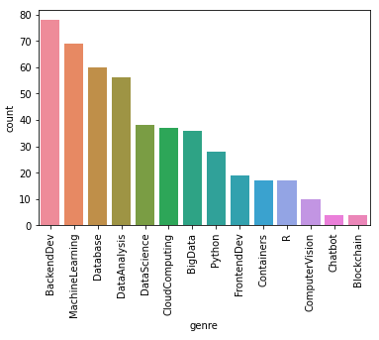
Course counts per genre
There are 307 courses in total
14 genres or topics have been manually defined
Each course can deliver contents related to several topics
In the figure, the distribution of courses that provide contents on each topic
5 most common genres: backend development, machine learning, databases, data analysis and data science.

Slide 7
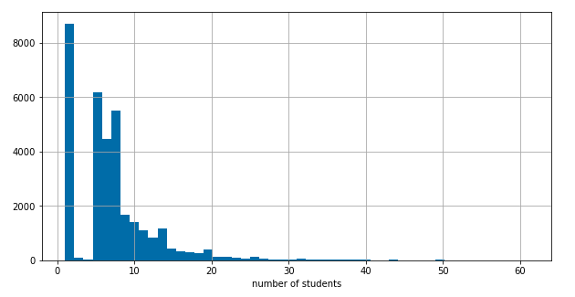
Course enrollment distribution
Each student can attend several courses and each course can have many students.
The course enrollment distribution seems to be a power law: most of the courses have one student enrolled, the number of courses with many students decreases rapidly with the number of students in them.
There is a gap for the courses with 2-5 students: there are barely no such courses.

Slide 8
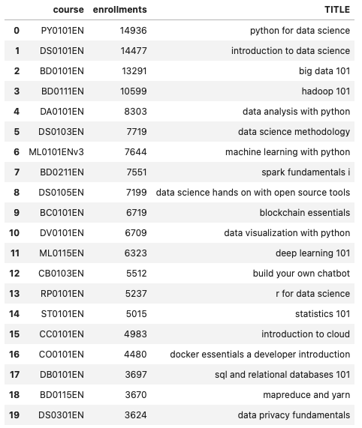
Twenty most popular courses
The figure shows the 20 most popular courses, by the number of enrollments.
The courses are in line with the most popular topics shown before.

Slide 9
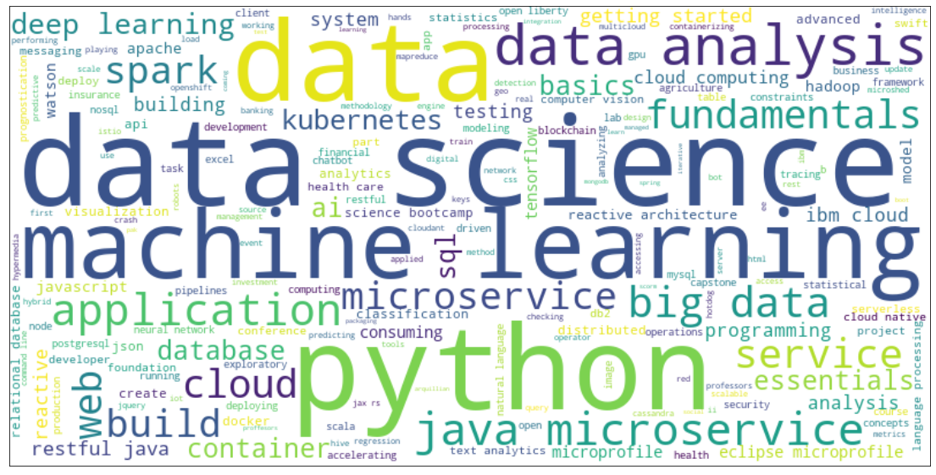
Word cloud of course titles
The word cloud visually shows the importance (i.e., number of occurrences)
of specific keywords in the titles of the courses.

Slide 10
Content-based Recommender System When user and course features (i.e., genres/topics) are known

Slide 11
Flowchart of content-based recommender system using course similarity
Course similarities are built from course text descriptions using Bags-of-Words (BoW). A similarity value is the projection of a course descriptor vector in the form of a BoW on another, i.e., the cosine similarity between both. Given the selected courses, the set of courses with the highest similarity value are found.
Flow chart of the data processing:
Raw data
Data processing
Cleaned datasets
Feature engineering
Features
Course titles and descriptions
Texts aggregated, stop words removed
Vocabulary generation, BoW descriptor generation
Each course defined as a BoW vector

Slide 12
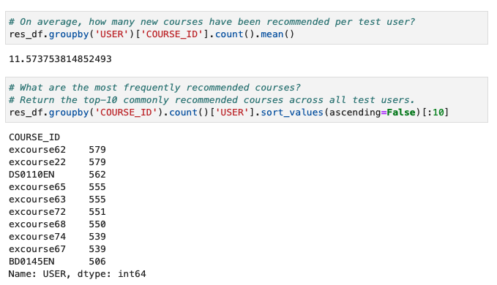
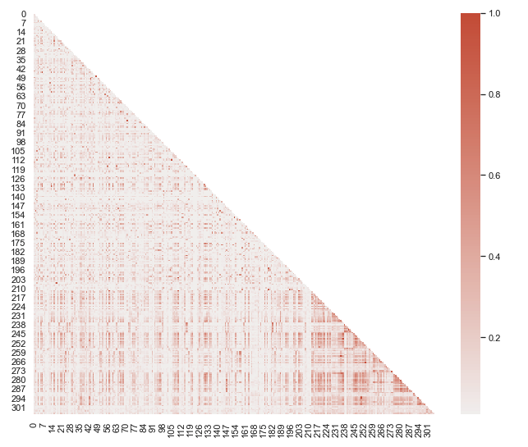
Evaluation results of course similarity based recommender system
Key evaluation questions:
Course similarity heatmap (1: very similar)

Slide 13
Flowchart of content-based recommender system using user profile and course genres
Courses have a genre descriptor vector which encodes all the topics covered by them. User profiles can be built by summing the user course descriptors scaled by the ratings given by the user. Then, for a target user profile, the unselected courses that are most aligned with it can be found using the cosine similarity (i.e., dot product) between the profile and the courses. Finally, the courses with the highest scores are provided.
Flow chart of the data processing and modelling:
Raw data
Feature engineering
Features
Modeling / Search
Most aligned courses
Courses with 14D one-hot encoded genre features
User ratings multiplied to attended courses and summed
User profiles
User profiles projected on course genre vectors
The courses with the highest projection score are taken

Slide 14
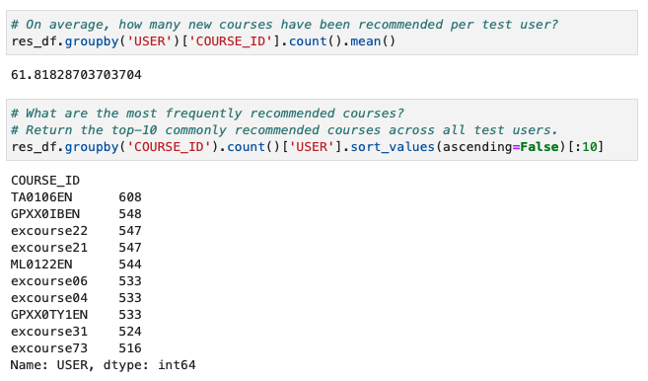
Evaluation results of user profile-based recommender system
Key evaluation questions:

Slide 15
Flowchart of clustering-based recommender system
Courses have a genre descriptor vector which encodes all the topics covered by them. User profiles can be built by summing the user course descriptors scaled by the ratings given by the users. Then, those users can be clustered according to their profile. This approach provides with the courses most popular within the user cluster.
Additionally, user profile descriptors can be transformed to their principal components, taking only a subset of them, enough to cover a percentage of the total variance, selected by the user.
Flow chart of the data processing and modelling:
Raw data
Feature engineering
Features
Modeling
Most aligned courses
User profiles
PCA decomposition
User profiles with reduced dimensionality
K-means clustering
Given the user cluster, select the most popular courses in that cluster

Slide 16
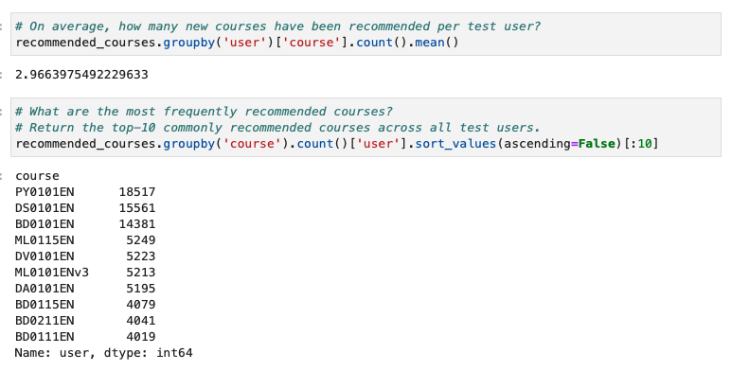
Evaluation results of clustering-based recommender system
Key evaluation questions:

Slide 17
Collaborative-filtering Recommender System When user and course features (i.e., genres/topics) are not known, or they are inferred

Slide 18
Flowchart of KNN based recommender system
Given the ratings dataframe, course columns are treated as course descriptors, i.e., each course is defined by all the ratings provided by the users. With that, a course similarity matrix is built using the cosine similarity. Then, for the set of selected courses, the most similar ones are suggested.
Flow chart of the data processing and modelling:
Raw data
Feature engineering
Features
Modeling / Search
Most aligned courses
(Dense) User ratings
Pivot ratings to create a sparse ratings matrix
Course descriptors consisting of all user ratings, i.e., course ratings columns
Compute similaty matrix between sparse course vectors
Select the most similar courses given a set of selected courses

Slide 19
Flowchart of NMF based recommender system
Non-Negative Matrix Factorization is performed: given the ratings dataset which contains the rating of each user for each course (sparse notation), the matrix is factorized as the multiplication of two lower rank matrices. That lower rank is the size of a latent space which represents discovered inherent features (e.g., genres). With the factorization, the ratings of unselected courses are predicted by multiplying the lower rank matrices, which yields the approximate but complete user-course rating table.
Flow chart of the data processing and modelling:
Raw data
Feature engineering
Features
Modeling / Search
Most aligned courses
(Dense) User ratings
Pivot ratings to create a sparse ratings matrix
Sparse user ratings
Apply NMF decomposition
Multiply the factorized matrices; for each unselected course, consider it if the predicted rating is high

Slide 20
Flowchart of Neural Network Embedding based recommender system
An Artificial Neural Network (ANN) which maps users and courses to ratings is defined and trained. If the user is in the training set, the ratings for unselected courses can be predicted. However, the most interesting part of this approach consists in extracting the user and course embeddings from the ANN for later use. An embedding vector is a continuous N-dimensional representation of a discrete object (e.g., a user).
The user and item embeddings extracted from the ANN are used to build a linear regression model and a random forest classifier which predict the rating given the embedding of a user and a course.
Flow chart of the data processing and modelling:
Raw data
Modeling
Outcome
Modeling
Most aligned courses
(Dense) User ratings
Map user & course to a rating value creating user & course embeddings in between
Rating prediction + embeddings
Define and train linear regression & random forest classifier on embeddings
Predict ratings of unselected courses given their and user embeddings

Slide 21
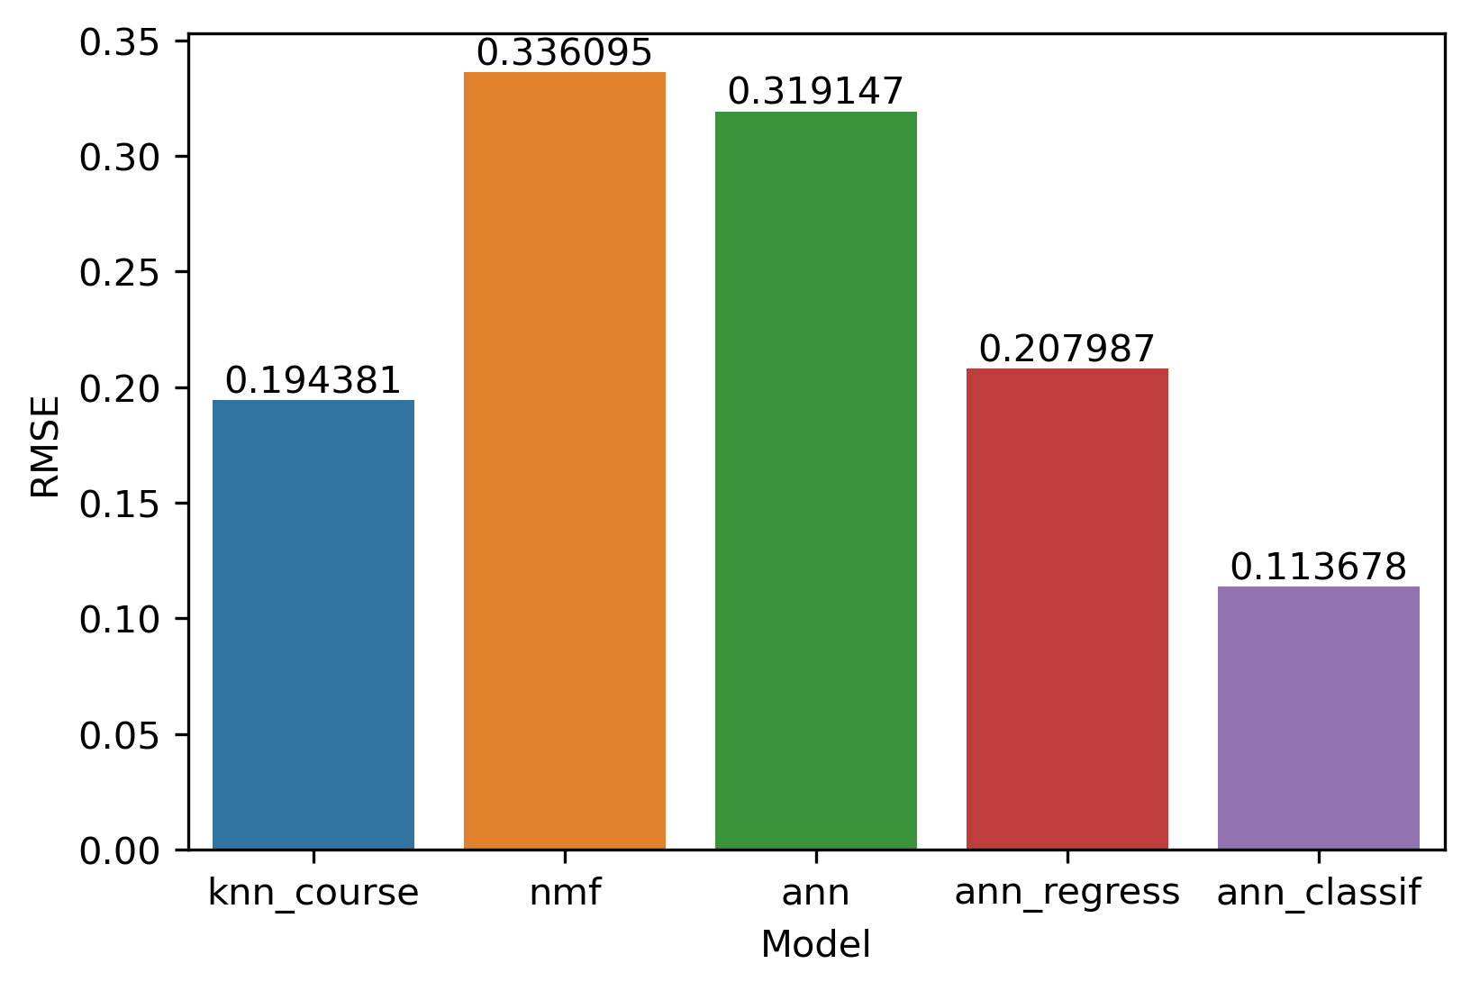
Comparing the performance of collaborative-filtering models
Root mean square error for the test split is shown in the figure
The most known method NMF yields the worst result
The random forest classifier with ANN embeddings yields the best result, followed by the KNN model created with the Surprise library, based on course neighboring (not users)

Slide 22
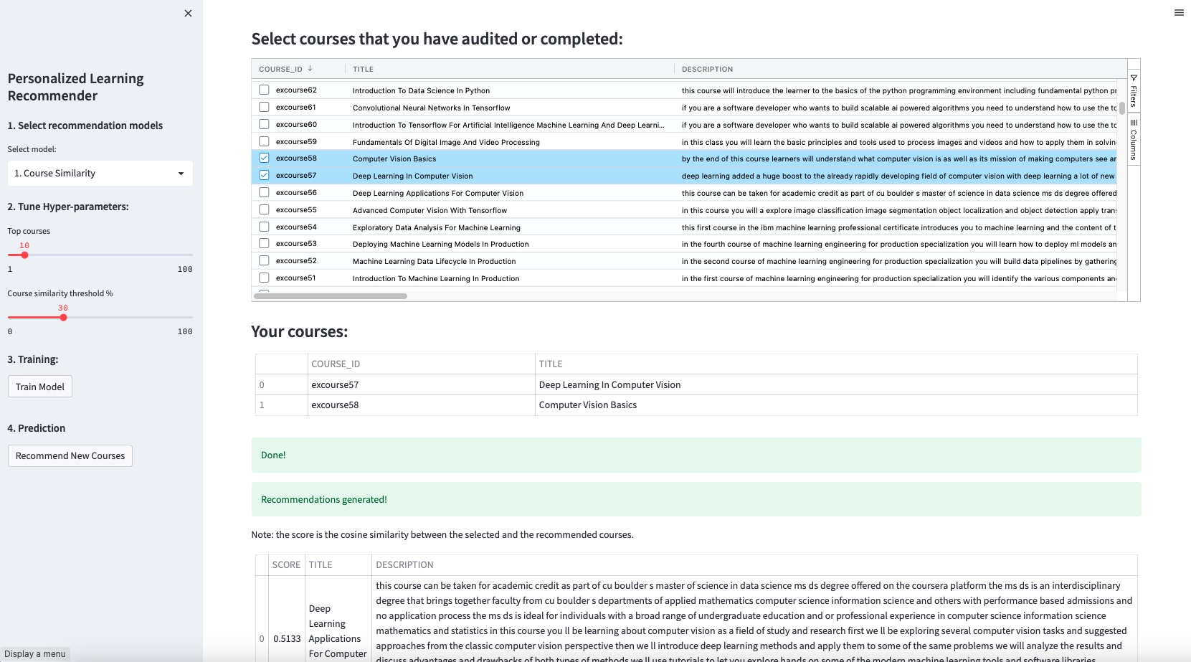
The course recommender system app with Streamlit deployed on Heroku
https://ai-course-recommender-demo.herokuapp.com
https://github.com/mxagar/course_recommender_streamlit

Slide 23
Summary and conclusions
Eight recommender systems have been created and deployed; these can be classified in two groups:
Content-based: when user and course features (i.e., genres/topics) are known
Collaborative Filtering: when user and course features (i.e., genres/topics) are not known, or they are inferred
Content-based systems work efficiently and provide similar results, but they require (manual) genre characterization for users and courses/items
Collaborative Filtering systems are based on the assumption that there is a relationship between users and items, so that we can discover the latent features that reveal user preferences
The collaborative system which seems to best predict the ratings is the random forest classifier that maps user and course embeddings (from the ANN) to rating classes (2 or 3). However:
The training time is the longest
The new users for whom we want to predict (and their example ratings) must be trained with the system so that they have an embedding representation

Slide 24
Appendix
Github repository: https://github.com/mxagar/course_recommender_streamlit
Notebooks: https://github.com/mxagar/course_recommender_streamlit/blob/main/notebooks
App:
https://github.com/mxagar/course_recommender_streamlit/blob/main/recommender_app.py
https://github.com/mxagar/course_recommender_streamlit/blob/main/backend.py
Deployment URL: https://ai-course-recommender-demo.herokuapp.com/

